Slide 1
Security Enhancements for Network Segregation
Henrik Ekholm

Slide 2
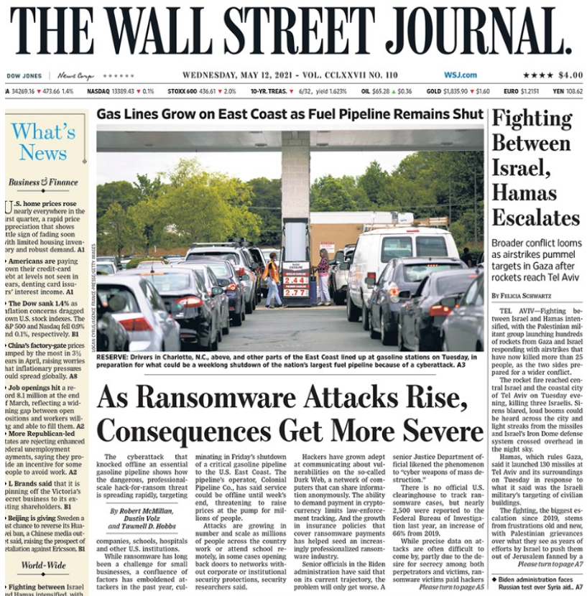
Reason
Cyber Attacks against Industry networks are on the rise
Overall average increase in Cyberattacks 25% per quarter (2019 Q4 – 2020)
Manufacturing most with 156%
High impact on daily life
Last big sector not already secured

Slide 3
Problem
Production Systems are notoriously hard to protect
Proprietary systems and protocols
Hard to monitor
Sensitive machines
Active probing can break systems
Time Critical response times
Delays cause ripple effects
Parallel running software can break processes

Slide 4
Process
What can be done?
Proprietary systems and protocols
No uncontrolled communication on network
Sensitive machines
Rely on passive monitoring methods
Time Critical response times
No extra software on devices

Slide 5
Process
What can be done?
Proprietary systems and protocols
No uncontrolled communication on network
Segment
Sensitive machines
Rely on passive monitoring methods
Canary servers
Log monitoring
Time Critical response times
No extra software on devices
Monitor communication instead

Slide 6
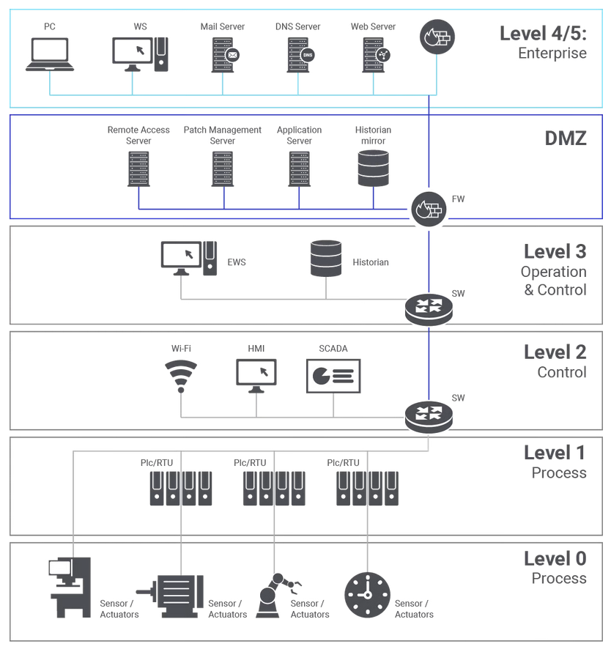
How to organize
The Purdue Model

Slide 7
Sorting
Adding all systems where they belong

Slide 8
Logging
Data historian
Central Log Collection
Forwards relevant logs to Elastic pool
Time synchronized

Slide 9
Sorting
Adding Data historian

Slide 10
Segmentation
Firewalls
Firewall 1 controlled by Corporate IT
Controls communication into Enterprise network
Firewall 2 controlled by plant Engineers
Controls communication into Manufacturing network
No direct communication can happen unless both teams agree
DMZ communication can happen unilaterally

Slide 11
Sorting
Implementing Firewalls

Slide 12
Remote access to production
Jump Server
Single server that allows remote access
Access brokered by PAM solution

Slide 13
Sorting
Adding Jump Server

Slide 14
Warning System
Canary Server
Any change to server causes alarm
Decoy servers, as similar configuration as others in use at the site

Slide 15
Sorting
Adding Canary

Slide 16
Controlling outbound communication
sinkhole / proxy server
All requests sent from Manufacturing network rerouted
If by IP, unexpected requests dropped at firewall
Whitelist is maintained for acceptable use
Unacceptable requests dropped with no response

Slide 17
Sorting
Adding Proxy/Sinkhole

Slide 18
Operationalize
Running the system
SOC team playbook with
Plant contacts
Reaction to Canary alarm
Log analysis
Infrastructure teams
Server and network maintenance

Slide 19
END, Questions?

Slide 20
Data historian:
osisoft-pi (as compatible with Siemens and Rockwell)
Jump server:
Hardened Virtual or on-site windows machine.
Beyond trust PAM also handles
Access groups managed with Azure AD
Canary server
Fortinets FortiDeceptor
Depending on other servers in use, standard is windows 2008 server
Proxy/sinkhole (tarpit)
Avamar as proxy
DNS sinkhole usable for known bad sites already implemented on corporate level

